Slide 1


Classification of computer
Aashish Subedi

Slide 2

Table of content: 1) Input Unit 2) Processing Unit 3) Output Unit 4) Basic cables used in Computer

Slide 3
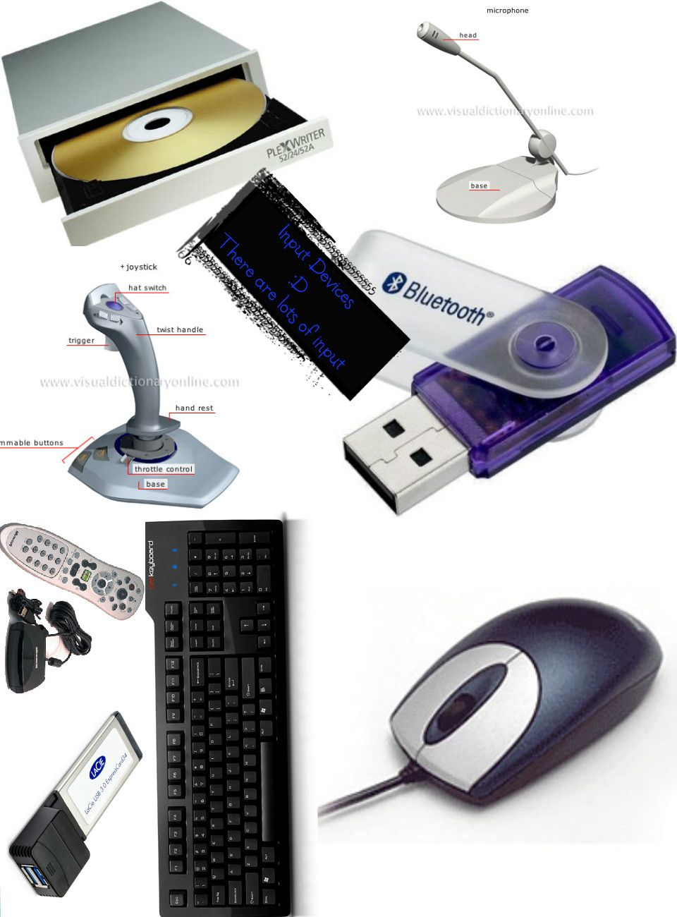
Input Unit:
Input Devices
The input unit consists of input devices that are attached to the computer.
These devices take input and convert it into binary language that the computer understands.
Some of the input devices are described below:
Keyboard: It takes input from the user in the form of text, numbers, and several other commands.
Mouse: It is a pointing device used to point anything in the monitor and used to play games and to use computer. It is also known as pointing device.
Joystick: Joystick is a device or a controller used to give instruction to the computer mainly while we are playing the video games like GTA V, Forza Horizon and others.

Slide 4

Processing Unit
Your ability to communicate effectively will leave a lasting impact on your audience
Effectively communicating involves not only delivering a message but also resonating with the experiences, values, and emotions of those listening

Slide 5
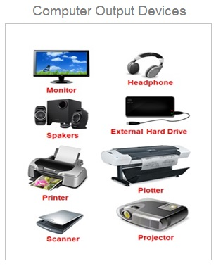
Output Unit:
Output Devices are the devices that show us the result after giving the input to a computer system.
Output can be of many different forms like image, graphic audio, video, etc. Some of the output devices are described below.
Some of the output devices are:
Monitor: A monitor is an electronic output device used to display information generated by a computer. It shows images, text, video, and graphics information via a computer’s video card.
Speaker: Speakers are electroacoustic devices that convert electromagnetic waves into sound waves.
Printer: A printer is a device that accepts text and graphics output from a computer

Slide 6
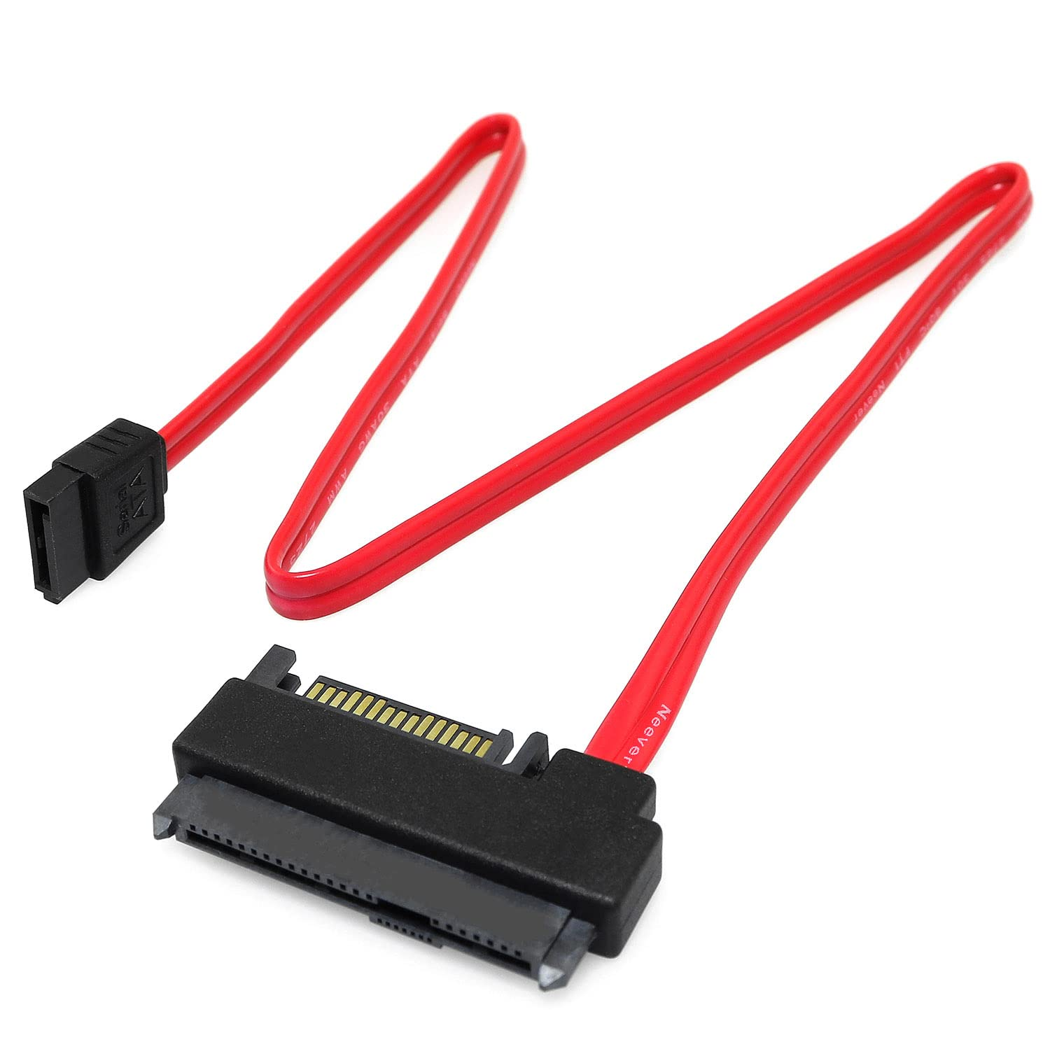
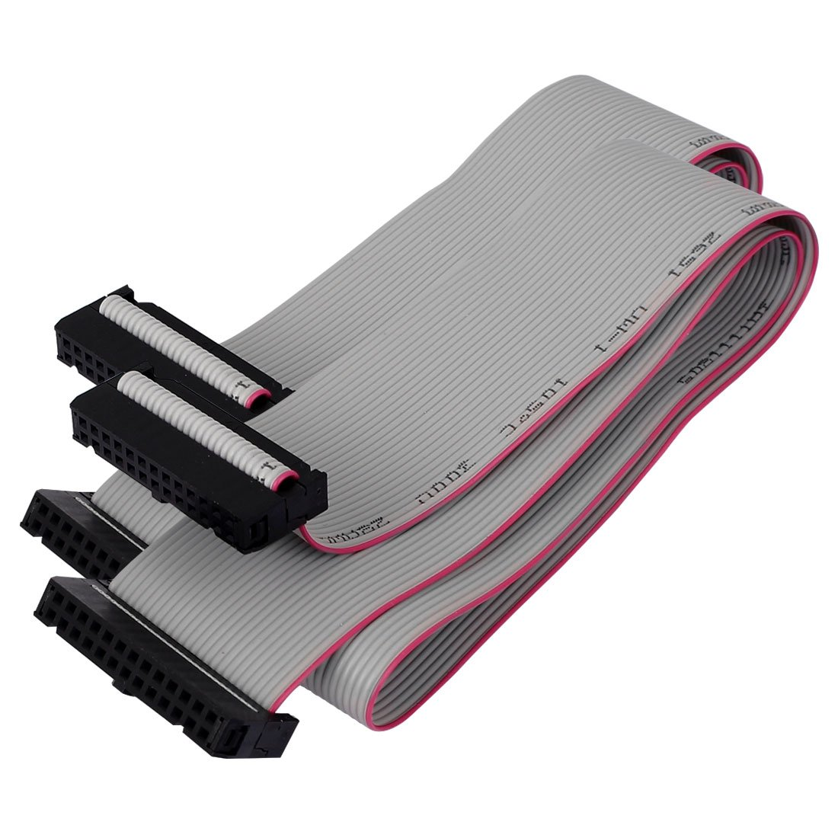
Basic Cables used in Computer
The major cables used in computer are:
SATA cables
SATA cables, short for Serial ATA cables, are primarily used to connect data storage devices like hard drives and optical drives to the motherboard of a computer. There are three main types of SATA cables: SATA I, SATA II, and SATA III.
PATA cables
PATA, short for Parallel ATA, is an IDE standard for connecting storage devices like hard drives and optical drives to the motherboard. PATA generally refers to the types of cables and connections that follow this standard.
Fig : Pata Cables

Slide 7
Thank you
Aashish Subedi​
ashisvlog12@gmail.com

